Slide 1
Zen and the art of the quantified self
Gary Monk

Slide 2



@garymonk
garywmonk
gary@garymonk.com

Slide 3
Tech
Obsessed
Health
Obsessed

Slide 4
Tech
Obsessed
Health
Obsessed
QS

Slide 5


Slide 6
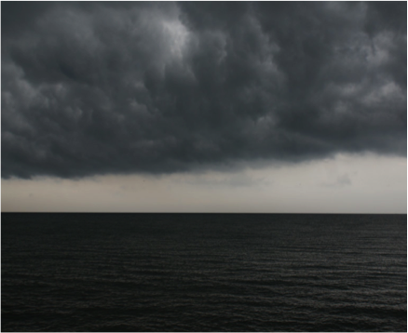
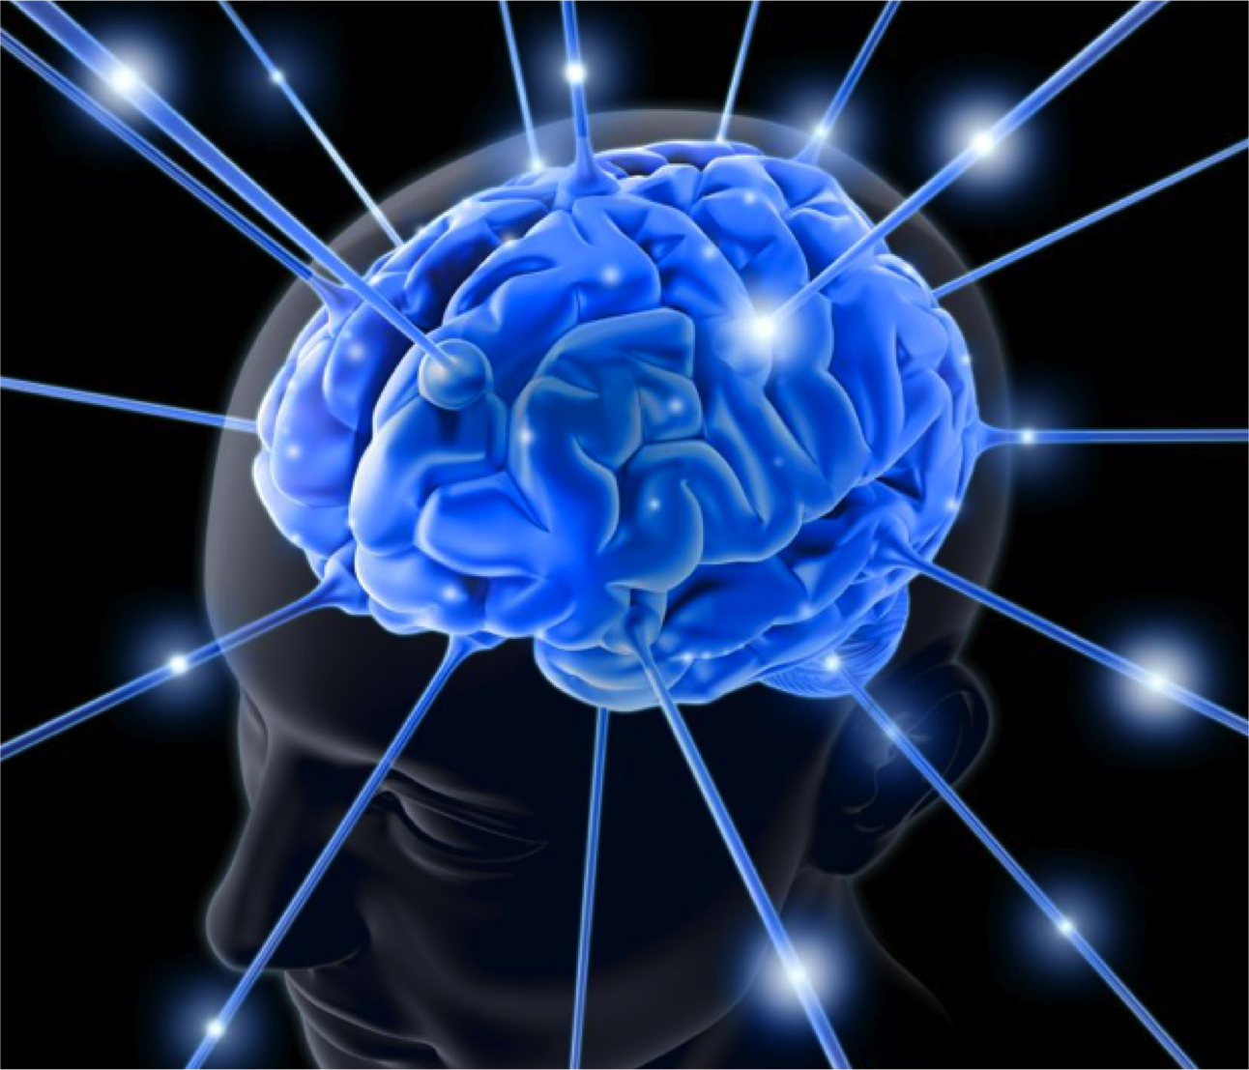
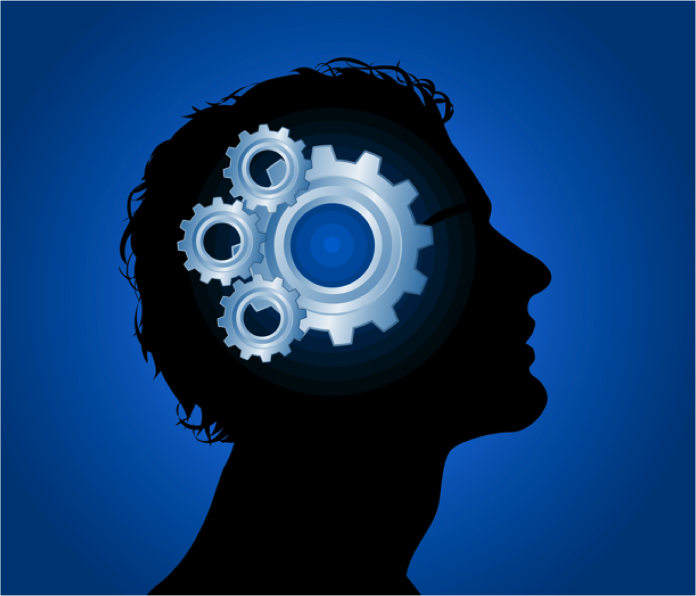

Slide 7
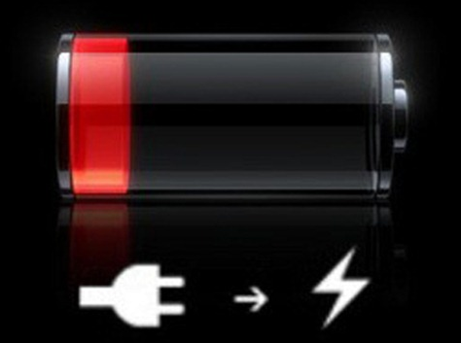

Slide 8
Objectives
Be more present
Slow down and gain perspective
Increase control over my thinking
Have more energy!

Slide 9
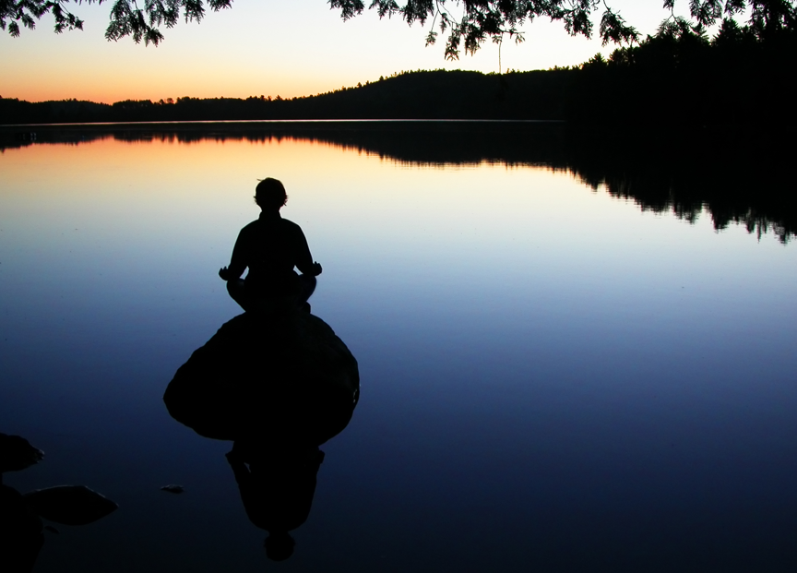

Slide 10
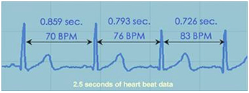
Heart Rate Variability

Slide 11
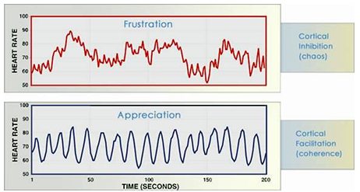
Heart Rate Variability

Slide 12
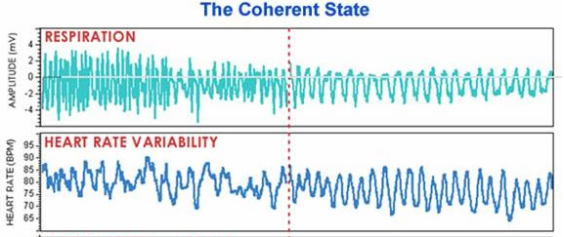
Heart Rate Variability

Slide 13
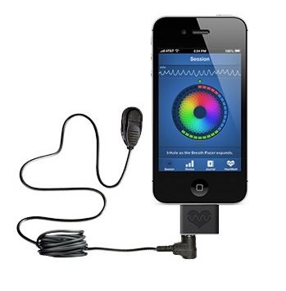

Slide 14
Objectives
Be more present
Slow down and gain perspective
Increase control over my thinking
Use Rhythmic Breathing
Heart Rate Variability biofeedback to achieve this, during everyday tasks

Slide 15
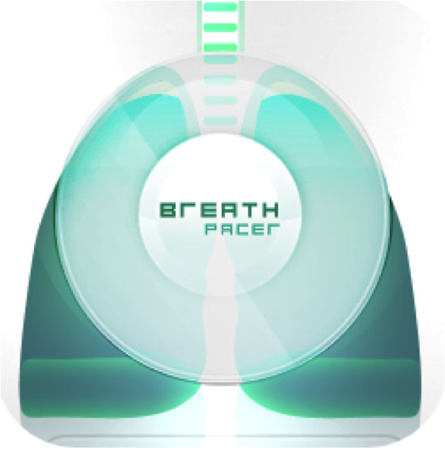
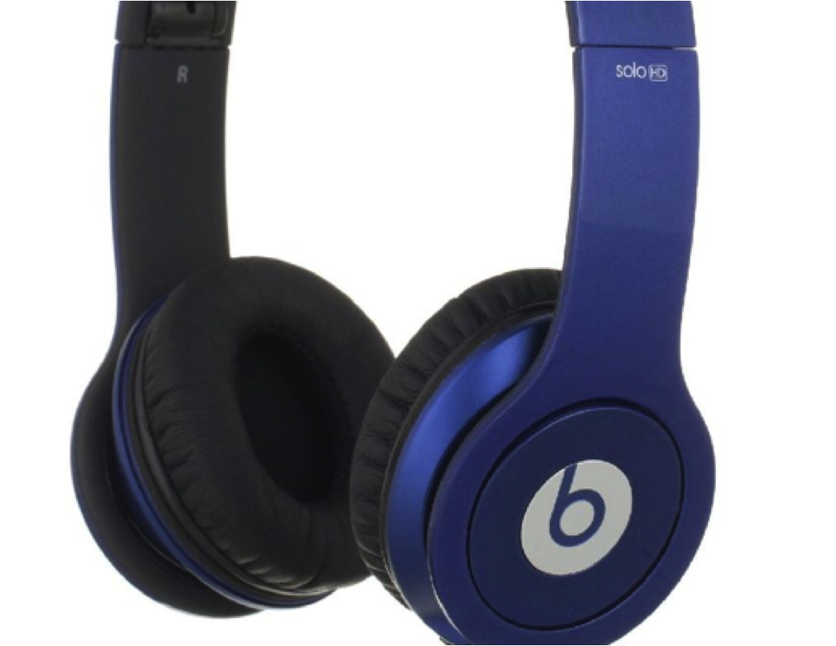
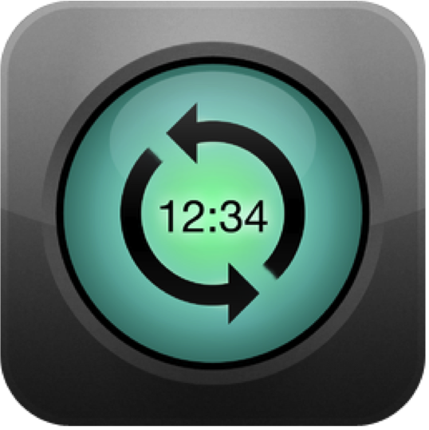

Slide 16
72615
4841 mins
40+ mins p/d
80+ hrs

Slide 17
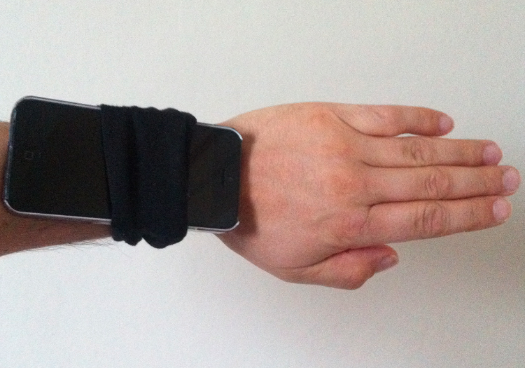

Slide 18
Method
7.5 BPM
120
Days
Control vs rhythmic breathing
Work & Life Tasks
10324
Mins
328
DPs
Coherence & relaxation scores

Slide 19
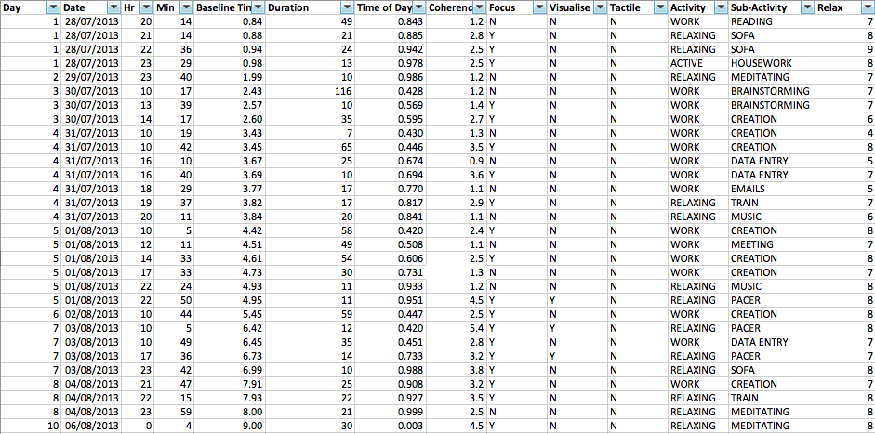
Method

Slide 20
The Data

Slide 21
Working
Average Coherence score

Slide 22
Working
Relaxation score
Coherence score

Slide 23
Relaxing
Average Coherence score

Slide 24
Relaxing
Relaxation score
Coherence score

Slide 25
Meditating
Average Coherence score

Slide 26
Meditating
Relaxation score
Coherence score

Slide 27
Summary

Slide 28
Summary across domains
Visual
8.4
4.7

Slide 29
Hear versus Touch

Slide 30
Hear versus Touch

Slide 31
Hear versus Touch
39
58
23

Slide 32
Meditation – relaxed versus coherence

Slide 33
Meditation No time?
Week

Slide 34
Meditation versus energy

Slide 35
Meditation versus energy

Slide 36
How have I felt?

Slide 37
The challenges
Data entry & device integration

Slide 38
Key conclusions
I can consistently raise my HRV while working (and living)
An increased HRV corresponds with greater relaxation levels
‘touch’ synchronisation of breath at least as good as ‘audio’
It has been a great tool to ‘relax’ & focus at work
It has changed my behaviour – dedicated meditation time

Slide 39
Key conclusions
I feel great!

Slide 40
Future research
EEG readings, Focus, concentration, working memory
Blood Pressure effects
Quantify other life metrics (e.g. centredness)
Sleep data

Slide 41
Questions?
@garymonk
garywmonk
gary@garymonk.com

